Slide 1

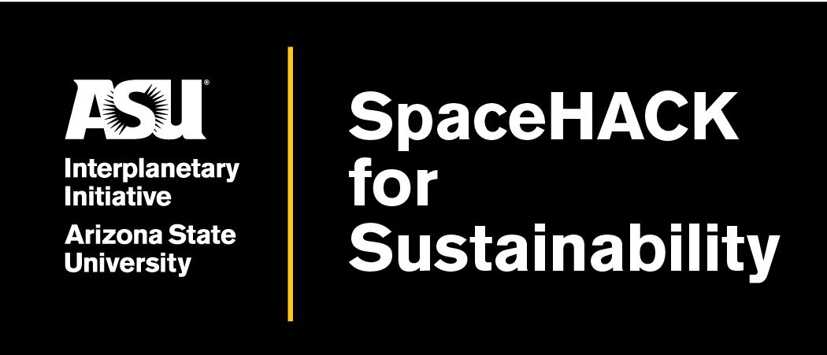
7
Team
Team Members:
Kadn, Computer Science (BS)
Gaurang, Computer Science (BS)
Shivani, Data Science (MS)
Amoreena, Data Science (BS)
Christopher Kosko, Architecture (MS)
Track:
Track: Food Insecurity
Notes:
Deliverables:
Host a daylong symposium exploring the question of how do we build a JEDI (just, equitable, diverse, and inclusive) space for all of humanity.
Develop and pilot test a survey that asks industry experts from every country on earth what a JEDI space means to them and how they would like to participate in co-creating that JEDI space.

Slide 2
Meet the Team
Gaurang Mohan - Computer Science (BS) and Data Science (Minor)
Shivani Chauhan - Data Science, Analytics and Engineering (MS) ,
Kadn Neal - Computer Science (Software Engineering) (BS),
Amoreena Ordonez - Data Science (Behavioral Sciences) (BS),
Christopher Kosko - Architecture (MS) and Urban and Environmental Planning (MUEP)

Slide 3
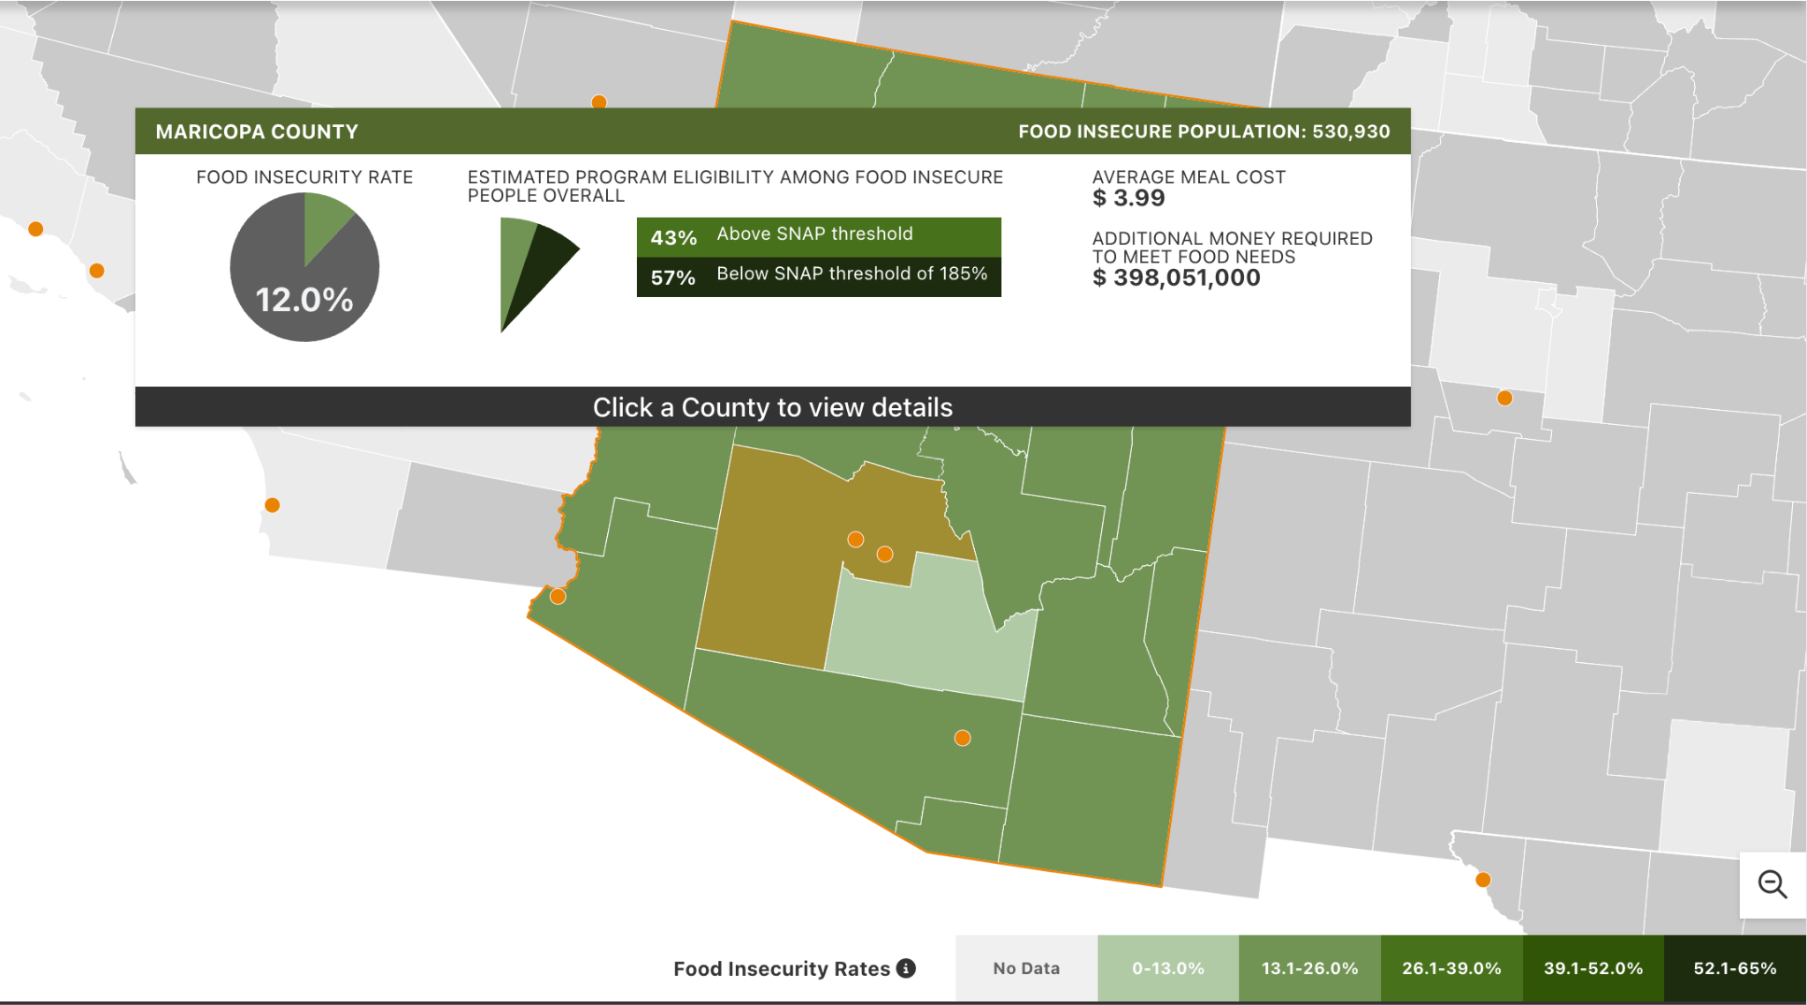
Problem Background
Based on 2022 data Maricopa county reports 12% of households as food insecure. This population has little to no easy access to healthful foods in their area. A myriad of factors can cause this issue including low income, distance from grocery stores/supermarkets, and access to a vehicle.
Out of these, 43% food insecure households fall above the threshold for qualifying for SNAP benefits. Since existing government funded programs are unable to reach a large percentage of food insecure households a different outreach/intervention must be considered.
https://map.feedingamerica.org/county/2022/overall/arizona

Slide 4
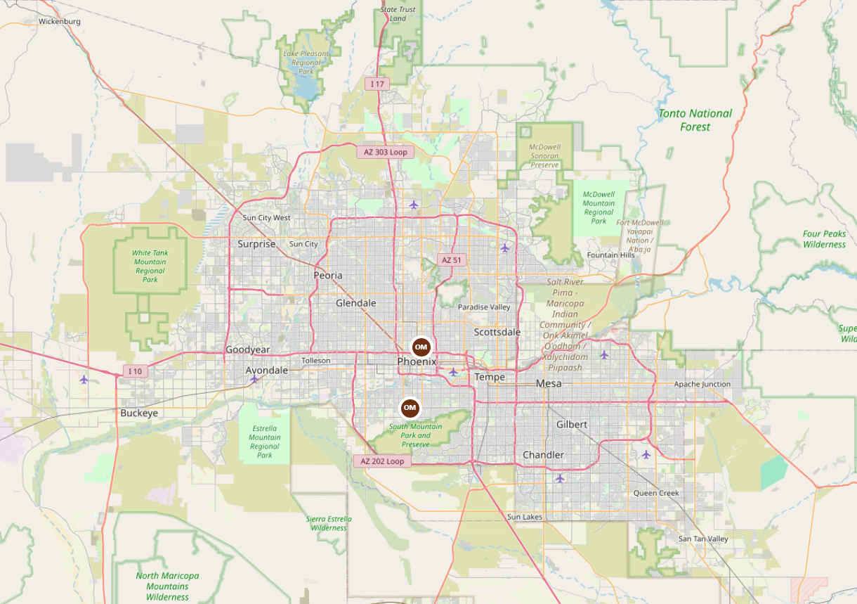
Approach
In exploring the existing infrastructure that may address food insecurity we found that among 1,778 on-farm markets across the United States, only 2 of them reside in the Phoenix area.
With low access to supermarkets, farm markets, and limits on income our group wanted to find a way to use satellite data to pinpoint suitable locations for urban agricultural development.
https://www.usdalocalfoodportal.com/fe/fdirectory_onfarmmarket/?operationmonth=operation_month_1%7Coperation_month_2%7Coperation_month_3%7Coperation_month_4%7Coperation_month_5%7Coperation_month_6%7Coperation_month_7%7Coperation_month_8%7Coperation_month_9%7Coperation_month_10%7Coperation_month_11%7Coperation_month_12&location_state=Arizona https://catalog.data.gov/dataset/farmers-markets-us-and-territories-2023-epa-region-93

Slide 5
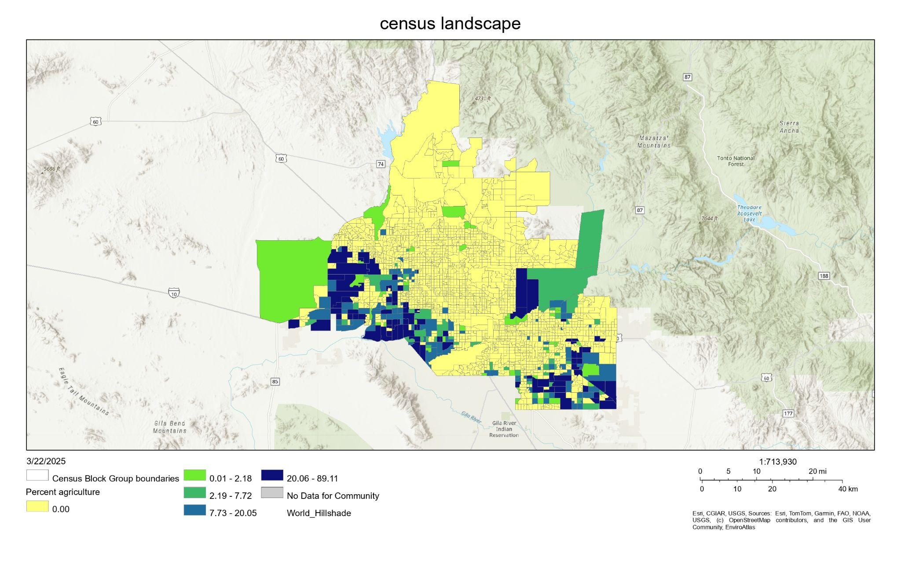
Executive Summary
Agriculture Land Use for Census Tracts - Percent Available
Copyright Text: EnviroAtlas https://enviroatlas.epa.gov/arcgis/rest/services/Communities/Community_BGmetrics/MapServer/20
Implementing government or community based interventions for food insecurity would be easiest on existing agricultural sites known to us.
Broken down by census tract we found that the agricultural land use in Phoenix existed mostly on the fringes of the city.
To address the areas without any agricultural land in place our team would need to create our own mapping system by layering available datasets and satellite imaging based on key factors.

Slide 6
Key Factors for Suitable Sites
USDA Food Access Atlas: To identify food desert boundaries
Census Data: To identify low income and low transportation access areas
USGS National Land Cover Database: To identify vacant/abandoned land parcels
Normalized Difference Vegetation Index (NDVI): To identify pre existing green spaces
NASA Soil Moisture Active Passive (SMAP): To identify land with appropriate soil moisture for agriculture
Openstreetmap Layer: The base map to visualize the topography of Phoenix, AZ

Slide 7
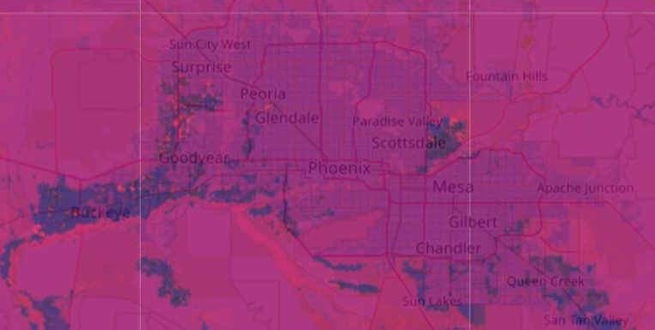
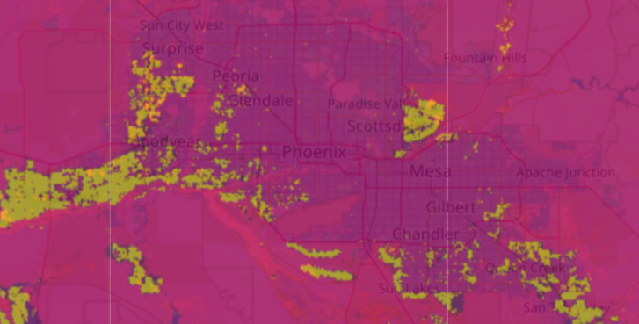
Urban Agriculture Is Scarce
On the right map, we see the LCMS Land Use dataset highlighting areas classified as agriculture or barren (yellow). When compared to the Cropland Data Layer (CDL) dataset on the left, the overlap is nearly identical — revealing that almost all open land in the Phoenix metro area is already classified as cropland.
This suggests that urban agriculture in the form of community gardens, food forests, or micro-farms is largely missing and not captured in existing datasets. To increase local food resilience, new policies or land access strategies are needed to reclaim underutilized urban spaces for small-scale food production.

Slide 8
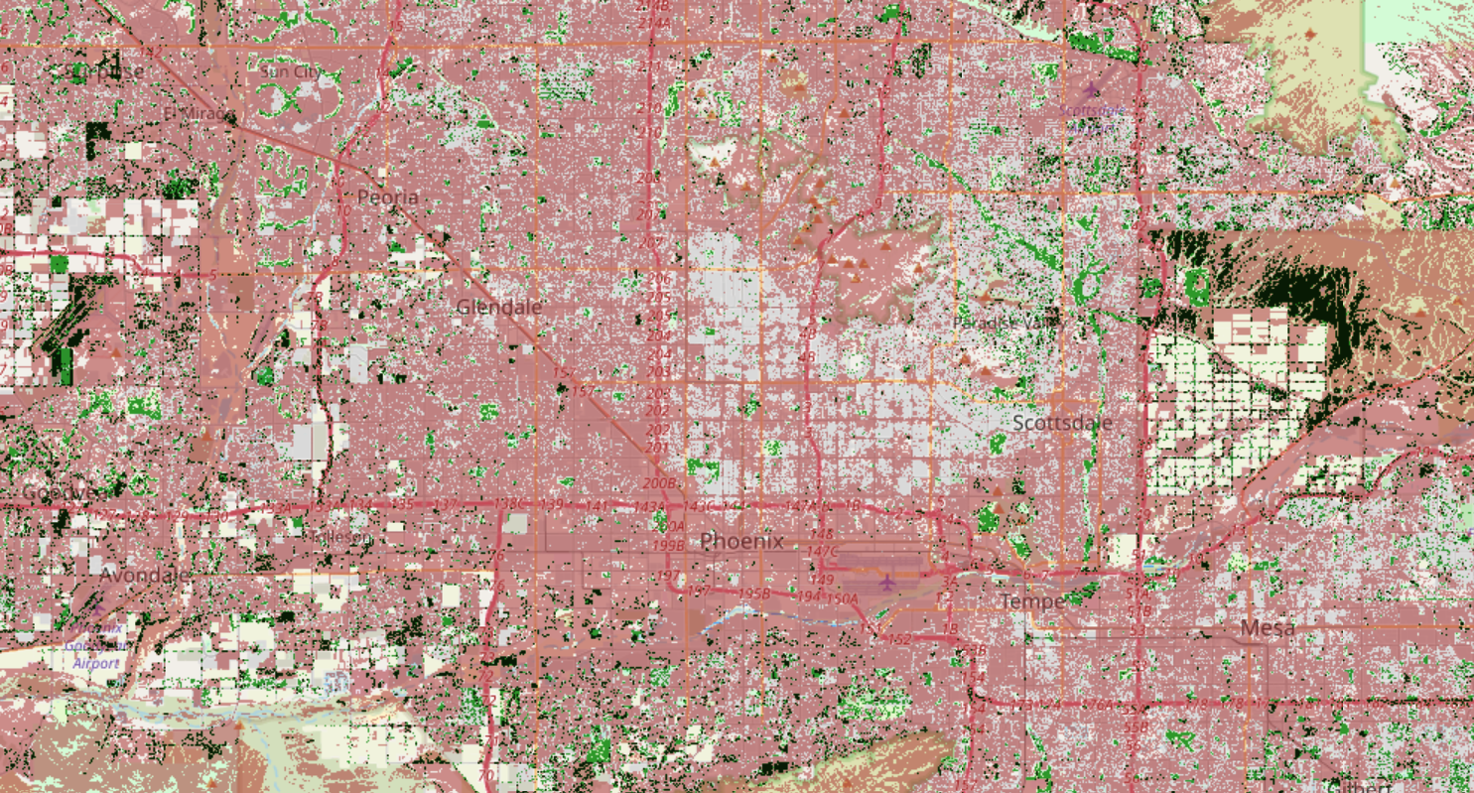
Possible Cultivable Land
🟩Grassland/Barren Land
🟫Low Vegetation
⬛Intersection
This map represents possible cultivable land by showing areas that have open grassland and low vegetation. This doesn't include cropland that's already in use and shows potential spots in congested areas where community gardens or other solutions can be implemented
Dataset Reference
USGS/NLCD Land Cover (2019)
Sentinel-2 Surface Reflectance (COPERNICUS/S2_SR)

Slide 9
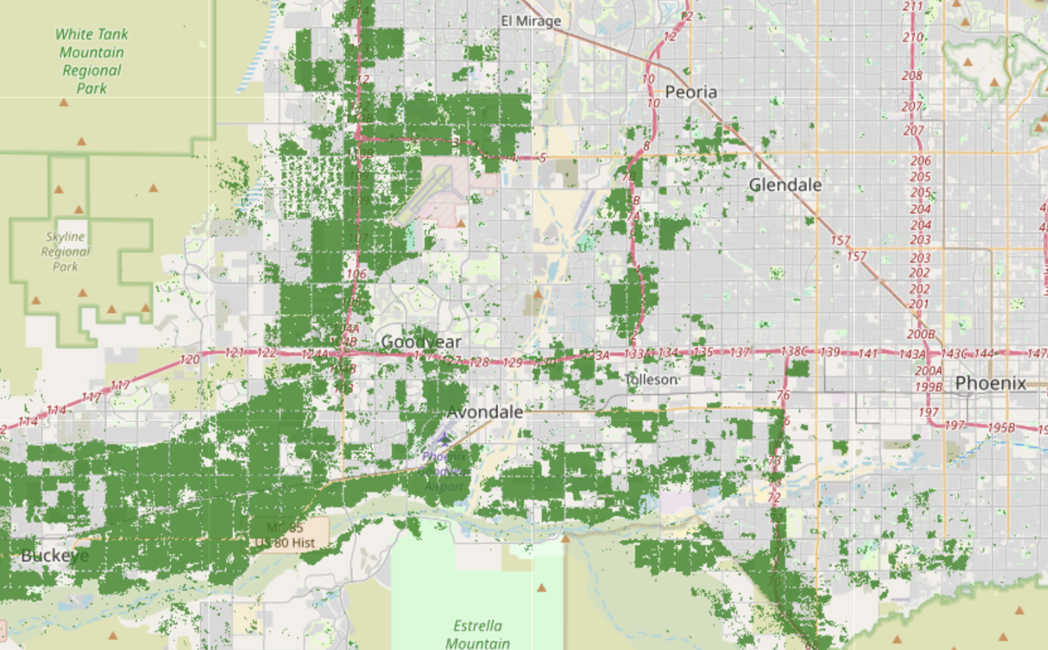
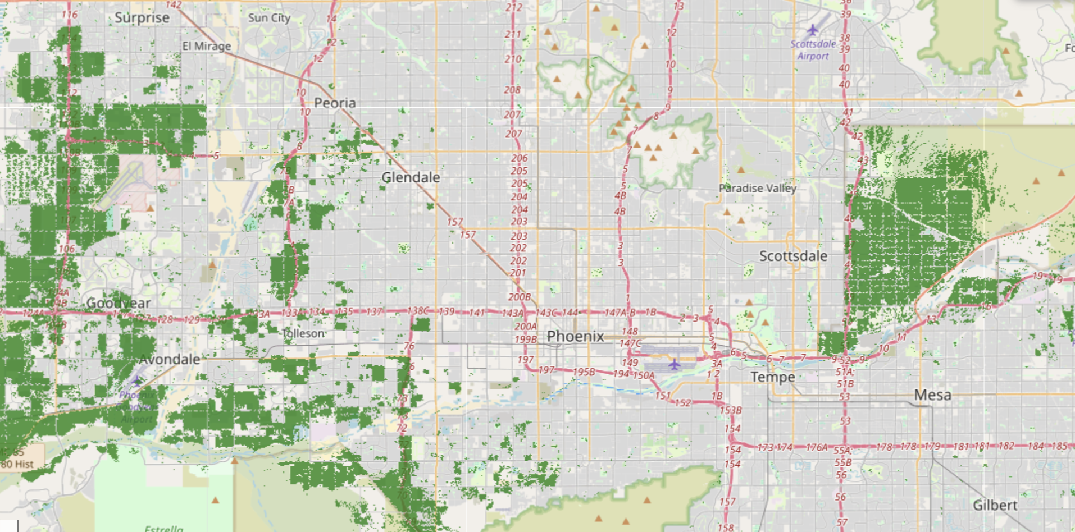
Identifying Food-Producing Land in the Phoenix Metro Area
This map highlights the cropland data and food-producing land in the Phoenix metro area using the USDA NASS Cropland Data Layer (CDL). By analyzing land cover classifications, we identify regions capable of supporting agriculture and food production, addressing food insecurity through targeted urban farming initiatives.

Slide 10
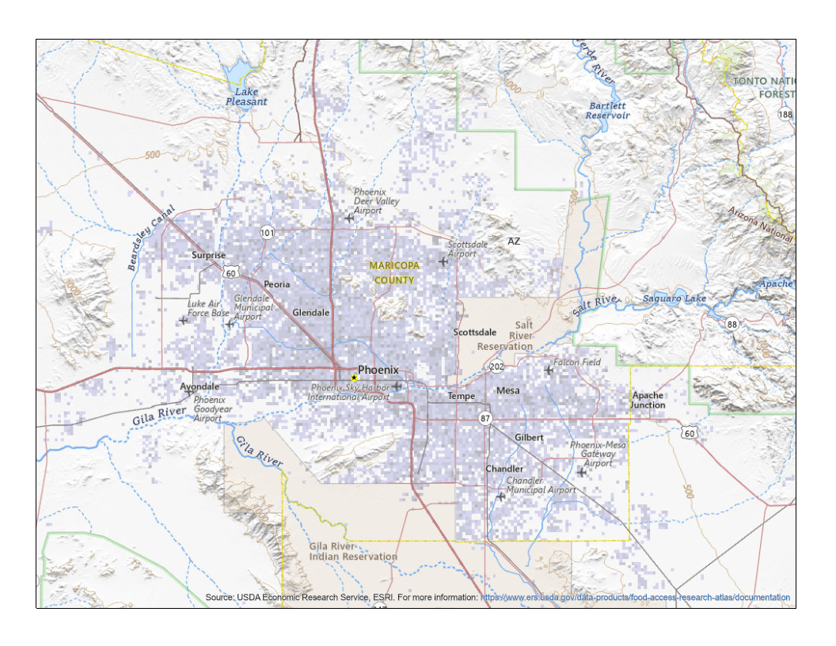
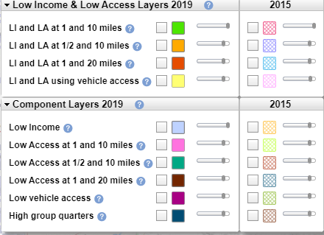
Correlation to Satellite Imaging
This map of low income population of Phoenix overlays nicely when we look at the maps we created for possible cultivable land. This suggests there’s ample opportunity to reach this population with urban agricultural interventions in the sites we’ve identified.
https://www.ers.usda.gov/data-products/food-access-research-atlas/go-to-the-atlas

Slide 11
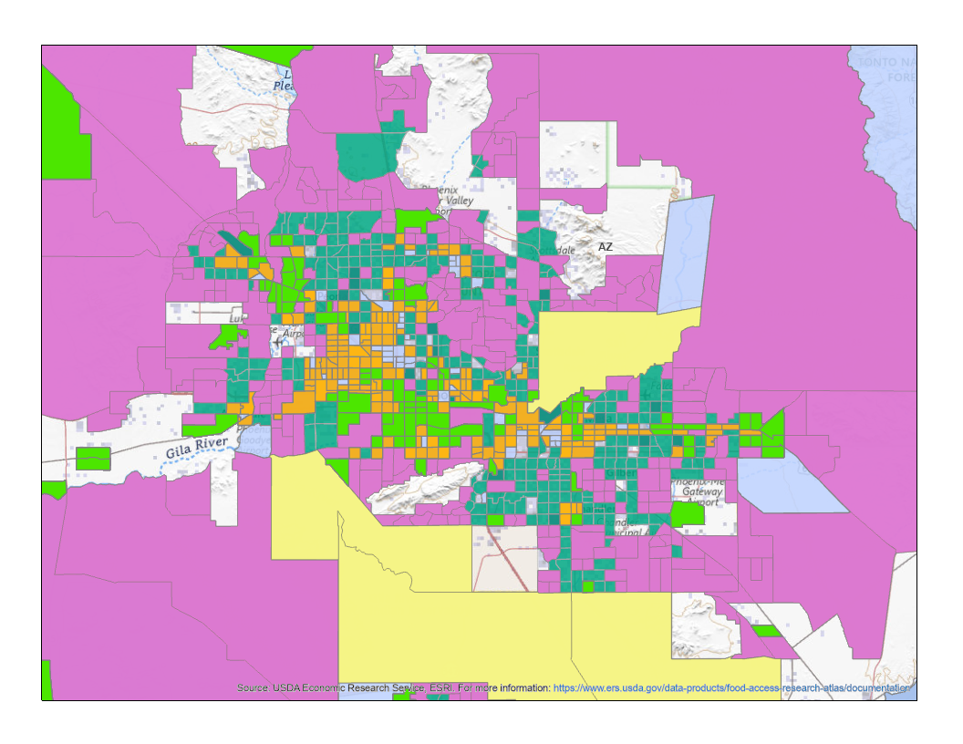
Correlation to Satellite Imaging Pt. 2
When we view Phoenix with parameters of low access to food, distance to supermarkets, and access to vehicles against our food producing land maps we find most of those areas correlate to low income and low access with mixed vehicle access. Developing initiatives in those areas could help people living with low vehicle access.
https://www.ers.usda.gov/data-products/food-access-research-atlas/go-to-the-atlas

Slide 12
Can Satellite data Impact Food Insecurity
After examination, visualization, and analysis of satellite imaging data of Phoenix, Arizona our team has concluded this can be a powerful tool to not only identify communities in the most need, but also propose areas for urban agricultural intervention.
Users can interchange the layers of satellite imaging to finetune exactly what kind natural & economic resources including land, soil quality, climate, and distance they may need to implement solutions for addressing food insecurity across the U.S. or worldwide.

Slide 13
Proposed Urban Agriculture Solutions
1. Community Gardens and Urban Farms: Open-access and harvest agricultural land maintained by volunteers or education programs. Removing the barrier of cost for fresh produce can help those within food deserts who are low income while also providing a place to learn how to cultivate food for personal gardens. Retain active farms. Incentivize developers converting agro lands in to homes to integrate legacy produces into master plan communities enabling the health and wellness of neighborhoods to thrive.
2. Farmers Markets: Placed into abandoned buildings/barren lands within food deserts. Community would be within walking distance of fresh local food reducing dependency on imports and creating accessibility. Arizona offers SNAP Double Up Food Bucks at farmers markets, incentivizing the community to patronize and farmers to participate.
3. Regenerative Urban Landscapes: Reuse. Repurpose, Recycle. Neighborhoods collect and place food waste into specified areas particularly in underutilized commercial centers that then feeds the soil to grow fresh foods. Increasing both the quality, quantity and access to fresh foods.

Slide 14
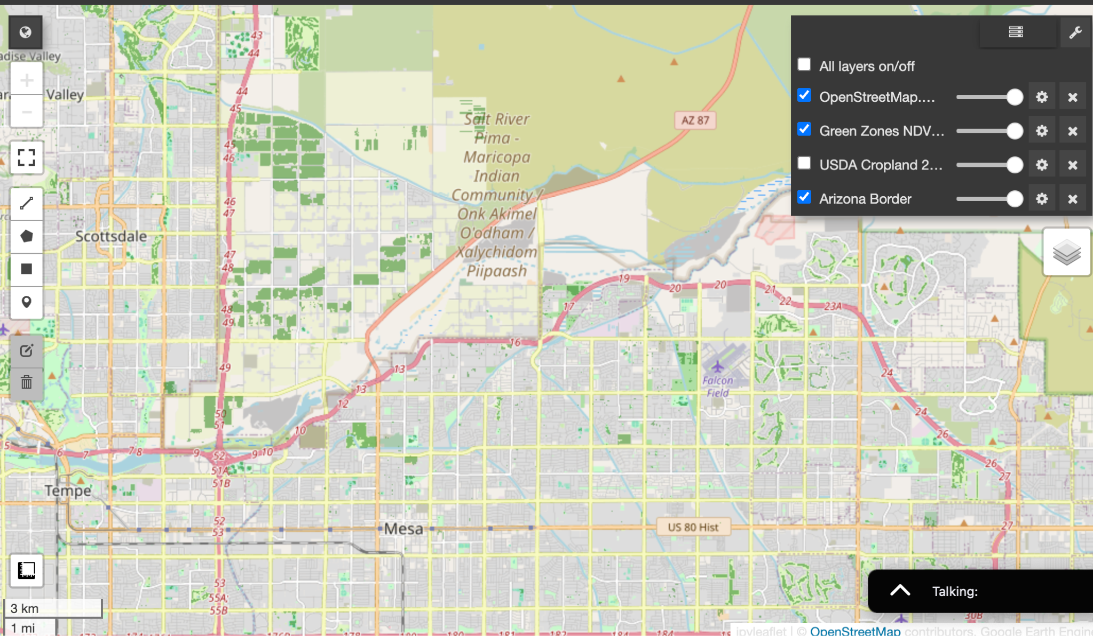
Land Use For Agriculture in Scottsdale
Current Use & Opportunity: The green regions are actively used for agriculture, indicating established infrastructure and potential for expansion.
Satellite-Driven Identification: Leverage satellite data (e.g., NDVI) to pinpoint additional areas suitable for urban agriculture in Phoenix.
Community & Policy Integration: Support community-driven initiatives and local policymaker collaboration to convert underutilized green zones into urban farms, enhancing food security.
Benefits & Challenges: Expanding urban agriculture can boost local food production and resilience, while requiring careful planning to address zoning and infrastructure challenges.

Slide 15
Satellite & Urban Technologies for Study
The effortless, odorless food recycler
It’s the smartest device in your kitchen. It’s easier than using a trash can. Mill turns would-be waste into resources for the Earth.
https://www.mill.com/
Own your source of drinking water
SOURCE® drinking water systems change the state of water, making clean drinking water for every person, in every place.
https://source.co/

Slide 16
References
Leveraged the Google Earth Engine API key provided in the hackathon resources to access and process high-resolution geospatial datasets.
Feeding America. (2025). Food insecurity among the overall population in Arizona.
U.S. Department of Agriculture. (n.d.). Urban Agriculture.
U.S. Department of Agriculture. (n.d.). Local Food Directories.
Food Access Research Atlas
Sentinel-2 (NDVI)
Landscape Change Monitoring System Conterminous United States version 2023-9 Land Use 2021
Landsat 8 Collection 2, Level 2: Earth Engine Catalog
USFS/GTAC LCMS (v2023-9) in Earth Engine
OpenStreetMap
Google Colab Notebook (1) - Our Team’s Work
Google Colab Notebook (2) - Our Team’s Work

Slide 17


Thank you
A special thanks to:
Professor Chavez,
Namig Abbasov,
Kerri Rittschof,
And Jeremiah Pate
for being extremely helpful and supportive throughout this Hackathon.

